Slide 1
Gender Equality and Macroeconomic Policy in Scotland
Professor Diane Elson and Dr Angela O’Hagan
Glasgow Caledonian University
March 2019

Slide 2
Macroeconomic Policy in Scotland
Macroeconomic policy, including the overall public expenditure control framework, are reserved matters.
This means that the UK Government’s decisions on the envelope for public expenditure and its allocation between UK Departments are still a major determining factor in the overall funding available for Scottish devolved public spending.
However, the Scottish government does enjoy new financial powers that were provided through the Scotland Acts 2012 and 2016.
The Scottish Government in 2018 produced its first 5 year Fiscal Outlook for Scotland and the information on slides 3 to 9 is taken from that.

Slide 3
Funding for the Scottish Budget
Scottish Government’s budget is now determined through a combination of block grant funding from HM Treasury, adjusted to reflect forecasts of receipts generated through taxes revenues devolved and assigned to Scotland.
The UK government has cut the block grant as part of its austerity policy. Over the decade between 2010-11 and 2019-20, Scotland’s discretionary resource budget allocation – the funding for day-to-day government expenditure – has reduced by more than 9 per cent or £2.6 billion in real terms.
The Scottish Government estimates that a further real terms reduction of around 1 per cent (approximately £250 million) in resource budgets between 2018-19 and 2022-23 is likely.

Slide 4
Devolution of Social Security
New social security powers under the Scotland Act 2016.
Likely to be a transfer to the Scottish Budget of more than £3.5 billion for these new responsibilities by 2022-23.
This level of funding assumes no changes to eligibility criteria and uprating policy by the UK Government.
Future increases in social security demand and new policy choices will
require to be funded from the Scottish Budget in the future.

Slide 5
Tax Powers of the Scottish Government
The Scottish Government has the power to set the rates and bands of income tax in Scotland – but not reliefs or exemptions, including the Personal Allowance.
It has no power over setting the level of VAT and no control over all other reserved taxes (including Capital Gains Tax, Corporation Tax, National Insurance Contributions and Inheritance Tax).
In Scotland, VAT is estimated to raise around £10 billion a year for the UK Government. The Scotland Act 2016 allows for receipts from the first 10p of the standard rate of VAT and the first 2.5p of the reduced rate of VAT in Scotland to be assigned to the Scottish Government.

Slide 6
More Tax Revenue But Smaller Block Grant
Revenues raised in Scotland up to financial year 2014-15 made up under 10 per cent of the overall funding for devolved expenditure.
By 2020‑21, with the assignment of Value Added Tax (VAT), they will make up approximately 50 per cent of that funding.
If devolved Scottish tax revenues per head grow at the same rate as in the rest of the UK, the Scottish Budget will be no better or worse off than before devolution.
This is because the amount being taken out through the Block Grant Adjustment is the same as the amount coming in through devolved tax revenues.
If per capita tax revenues grow faster in Scotland than the rest of the UK then the Scottish Budget is better off than would have been the case under pre-devolution funding arrangements.

Slide 7
Capital Borrowing Powers
The Scottish Government’s capital borrowing powers were originally granted in the Scotland Act 2012 and the limits were increased in the Scotland Act 2016.
The Scottish Government can increase capital expenditure through borrowing up to £450 million per year up to a maximum total of £3 billion.
It may borrow from the UK Government through the National Loans Fund; through a commercial loan (directly from a bank or other lender ); and by issuing bonds. To date it has borrowed exclusively from the UK Government.
The 2018-19 Scottish Budget plans to make full use of the £450 million capital borrowing powers available to maximise infrastructure investment.

Slide 8
Borrowing to Cover In-year Excess of Expenditure over Income
The Scottish Government can borrow up to £600 million each year within a statutory overall limit for resource borrowing of £1.75 billion, to cover temporary short term deficits.
If an economic shock occurs it is not possible for the Scottish Government to apply resource borrowing to provide an economic stimulus – only to meet a shortfall in tax receipts or demand-led social security spending.
The resource borrowing power is deliberately restricted to very specific circumstances and does not detract from the fundamental requirement for a balanced Scottish Budget each financial year.

Slide 9
Scotland Affected by Austerity Policies of UK Government
Since 2010 UK governments have cut social security benefits, and cut spending on public services , including the Block Grant to Scotland,
VAT has been increased but income tax has been reduced through successive changes to tax threshold and corporation tax has been reduced.
Scottish government has expressed concern that the austerity policies disproportionately impact the most disadvantaged individuals.
It has also noted that UK Government could adopt a more gradual deficit reduction with a better balance between ensuring the sustainability of the UK public finances and investing in the public services which are vital to supporting households and long-term economic growth.
Such an approach could potentially provide an additional £7 billion in investment for Scottish public services relative to current plans.

Slide 10
The Gender Impact of Macroeconomic Policy
UK Equality and Human Rights Commission (2018) report on the cumulative impact of tax and welfare reforms in England, Scotland and Wales finds women on average in Great Britain lose more from austerity policies than men.
The average loss for Great Britain as a whole is 400 pound a year for women, 30 pound a year for men.
Low income women suffer the worst income losses, principally due to the cuts to social security.
Better-off women gain but by less than men.
See Handout 1

Slide 11
Methods and Data
Impact on disposable income is modelled using a micro simulation model
Data is from UK Family Resources Survey and UK Living Costs and Food Survey.
Time period covered is 2009/2010 to 2021/2022
Changes measured against ‘business-as-usual’ scenario. i.e. final tax-transfer system before the May 2010 general election and uprating that system using the default rules in place for the previous Parliament.

Slide 12
Measures Included in Gender Impact Assessment
Income tax
National Insurance Contributions
Council Tax
Means-tested and non-means-tested benefits
Tax credits
Universal Credit (UC), in so far as rolled out

Slide 13
Gender Impact in Scotland
Women on average lose more than men, but the loss is less than the Great Britain average
Poor women lose the most, but their losses are less than the Great Britain average
Rich men and women lose, but in Great Britain as a whole they gain.
See Handout 2. Compare to Handout 1.

Slide 14
Discussion
What might account for the difference between Scotland and Great Britain?
Why might women on average lose more than men in both?

Slide 15
Why Do Women Lose More?
Women receive an average of around £7,900 per year in transfer payments compared with around £6,550 per year for men ( GB averages)
This is partly because 90% of lone parents with dependent children are women, and partly because women are more likely to receive benefits and tax credits in couples with children.
Men benefit slightly more on average than women from the changes to income tax and NICs.
This is mainly because women are more likely to be full-time homeworkers looking after pre-school children. Women are also more likely than men to work part-time and on average to have lower hourly earnings.
Women are therefore less likely to benefit from the full value of the increase in the income tax personal allowance, which is the main direct tax cut introduced since 2010.

Slide 16
Policy Differences Between Scotland and Great Britain
Additional funding from the Scottish Government to mitigate the impacts of the ‘bedroom tax’
Increases in the multipliers for Council Tax bands E, F, G and H
Council Tax Reduction Scheme for low-income households
An increase in Carers’ Allowance to the level of Jobseeker’s Allowance (from summer 2018)
Best Start Grant for low income mothers, planned for introduction in
2018–19, which replaces the Sure Start Maternity Grant
Changes to income tax rates in Scotland from 2018–19 onwards.

Slide 17
BREAK

Slide 18
Structure of the Scottish Budget
The Scottish Budget for any given year is determined by the combined impact of:
block grant funding allocated by HM Treasury at a Spending Review, Autumn Budget or Spring Statement, adjusted to reflect taxes devolved to Scotland through the Scotland Act 2012 and the Scotland Act 2016;
independent forecasts of receipts generated by those taxes and devolved social security spend; and
planned use of the available devolved borrowing powers and use of the Scotland Reserve.

Slide 19
Composition of the Scottish Budget

Slide 20
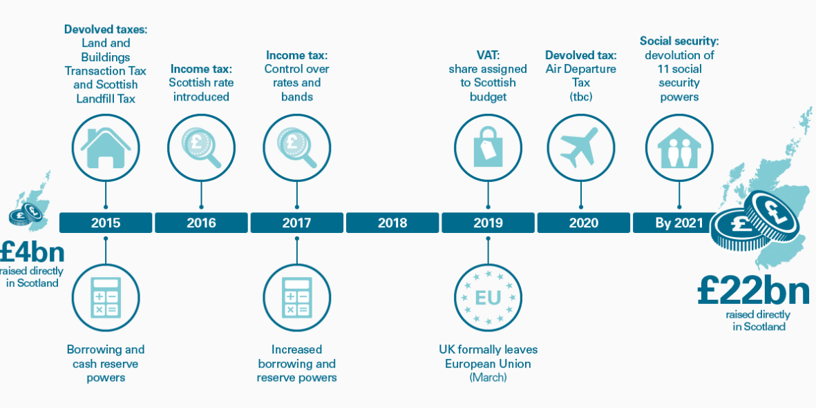
Fundamental change in public finances

Slide 21
Scotland’s tax base
4.5 million working age adults
2.5m pay tax
2.m < minimum threshold = non-IT payers
300,000 fewer women tax payers.

Slide 22
Scottish Income Tax

Slide 23
Gendered differences across the current Income Tax Bands
How do you think women and men are distributed across the Tax Bands?
What proportion of non tax payers are likely to be women and men?
What do think might be the impacts
of the UK Govt policy to raise the tax threshold?
and the SGvt decision to raise the higher end tax rates?
What are the gendered characteristics of the Scottish labour market that have implications for expanding the tax base?
What policies to promote economic growth could improve the tax base and advance improved gender equality outcomes?
Notes:
4.5m working age adults
2.5 m pay tax
2m working age adults in Scotland with income below PA of £12,500
300,000 fewer women tax payers
[Answers from UKWBG Assessment p.11 2018]

Slide 24
What else to do?
Use borrowing powers to invest – in what?
What do we mean by investment?
Increase spending in economic development/skills/Fair Work portfolio?
– current share of 2019-20 budget
What sectoral development would diversify labour market participation and occupations?

Slide 25
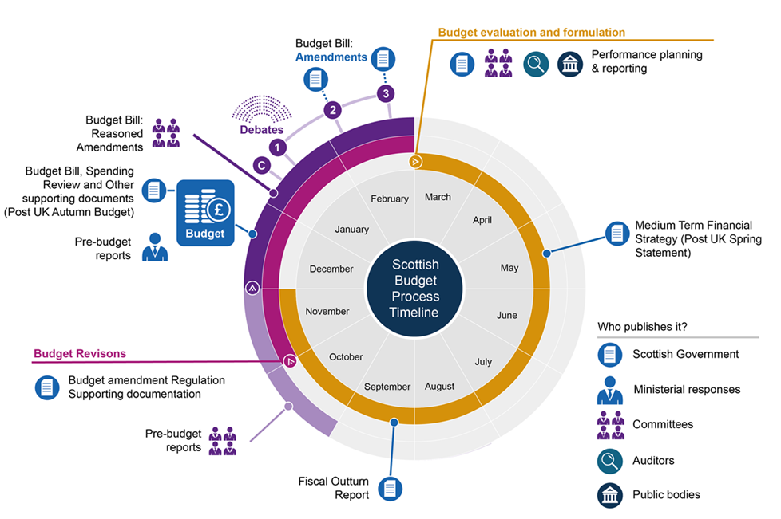
Considering equalities in the budget
Budget documents
Equality Statement published with budget documents
Budget evaluation and formulation
Additional equalities information to be published before summer recess

Slide 26
Opportunities for scrutiny and gender analysis

Slide 27
New budget process – what does it mean for you?
What is coming your way?
Parliamentary committees – increased evidence and scrutiny.
Medium Term/Scotland’s Fiscal Outlook – gender, equality, human rights issues and analysis?
Summer scrutiny and pre-budget reports.
Linking Budget –equalities analysis - NPF
What sources of information?
What type of analysis?
What processes support/underpin improved equalities scrutiny between budget allocations and outcomes?
Alternatives to Equality Budget Statement?
New/additional equalities analysis at summer scrutiny?
Pre-budget reports?

Slide 28
Resources
Distributional Analysis: https://www.equalityhumanrights.com/en/publication-download/cumulative-impact-tax-and-welfare-reforms
Gender Analysis of the Scottish Budget: https://www.engender.org.uk/content/publications/GENDER-EDIT-OF-THE-SCOTTISH-GOVERNMENT-BUDGET-2019-2020.pdf
Gender Analysis of the Autumn Budget: https://wbg.org.uk/analysis/autumn-budget-2018-wbg-full-analysis/

